Slide 1


BIG DATA II – Final Project Prof. Namini
Arun Kumar Halihal Shanmukachary

Slide 2
Data Set: Monthly Advance Retail Sales (Excluding Food Services)”
Introduction
Variables in the data set:
month : indicates the month of the year
retailsales: US monthly retail sales excluding food services in millions of dollars
percapitaincome : US Personal income per capita
population: US population in thousands
unemployment: US unemployment rate in percentage
inventory: US retailer inventory in millions of dollars
yoygtenp: classification variable with binary values YES or NO --> if year over year Retail sales growth is above 10% in a month?
inventorygrowth: year over year inventory growth
percapitagrowth: year over year growth in percapitaincome
inventorygrowthabovefive: classification variable that has value as YES for above 5% year over year growth in inventory and NO for below 5% year over year growth in inventory
percapitagrowthabove: classification variable that has value as YES for above 5% year over year growth in percapitaincome and NO for below 5% year over year growth in percapitaincome
We have to use some variables for regression models and some variables for the classification models though out outcome variable will be focused on the retail sales.
Source of the data: fred.stlouisfed.org

Slide 3
Objective: 1) Regression: To explore the retail sales time series and project the retail sales using the validation and test data with the help of explanatory variables that include percapitaincome, population, unemployment and inventory. 2) Classification: To classifying if Retail sales growth is above 10% in a month (yoygtenp) using the predictor variables that include inventorygrowthabovefive and percapitagrowthabove.
Introduction
 |  | Regression
 | RMSE | MAE | Outcome | Predictors
Multi Linear Regression | 23907 | 16312 | Retailsales | All Variables
Backward Elimination | 24036 | 16434 | Retailsales | Percapitaincome, Population and Inventory
Lasso | 23901 | 16310 | Retailsales | All Variables
LassoCV | 24228 | 16514 | Retailsales | All Variables
Ridge | 34241 | 27284 | Retailsales | All Variables
Bayesian Ridge | 91500 | 75407 | Retailsales | All Variables
Regression tree | 26796 | 18357 | Retailsales | All Variables
 |  | Clssification
 | Accuracy | Outcome | Predictors
KNN Model | 77% | yoygtenp | Inventory Growth and Population Growth
Naïve Bayes | 77% | yoygtenp | inventorygrowthabovefive and popuulationgrowthabove
Classification Tree | 44% | yoygtenp | inventorygrowthabovefive and popuulationgrowthabove
Ensembles/Single tree | 69% | yoygtenp | inventorygrowthabovefive and popuulationgrowthabove
Ensembles/Bagging | 69% | yoygtenp | inventorygrowthabovefive and popuulationgrowthabove
Ensembles/Boosting | 69% | yoygtenp | inventorygrowthabovefive and popuulationgrowthabove
Logistic Regression | 97% | yoygtenp | inventorygrowthabovefive and percapitagrowthabove

Slide 4
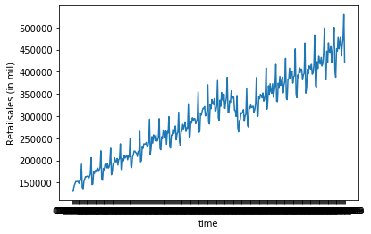
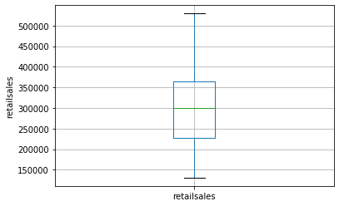
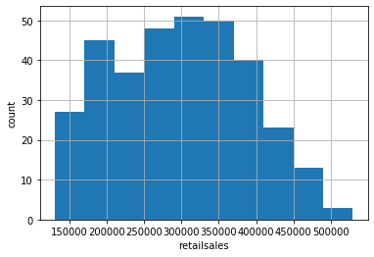
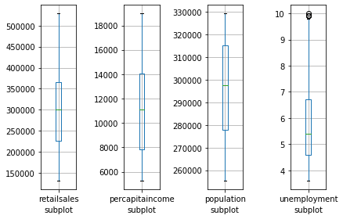
Data Visualization
Plot 1: The line graph of retail sales indicates that the time series is a trend with seasonality involved in it. We will examine regression models to forecast the retail sales using other variables.
Plot 2: A box plot shows median value of time series of retail sales as $300 billion, first quartile as about $230 billion, third quartile as about $370 billion, maximum above $500 billion and minimum of below $150 billion.
Plot 3: A histogram plot that shows how retail sales is dispersed. The plot shows that the distribution is right skewed with more values falling to the left of the mean. The frequency is very high close to the mean and less towards the outlier. The frequency drops at higher value of retail sales which makes the distribution skewed.
Plot 4: Box plot of retail sales, percapitaincome, population and unemployment variables.

Slide 5
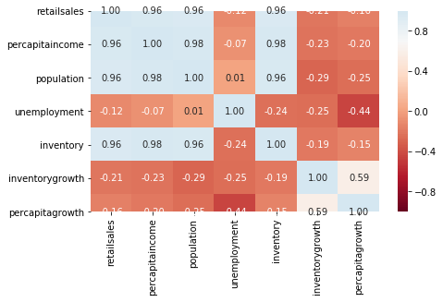
Data Visualization
 | retailsales | percapitaincome | population | unemployment | inventory | inventorygrowth | percapitagrowth
retailsales | 1 | 0.96 | 0.96 | -0.12 | 0.96 | -0.21 | -0.16
percapitaincome | 0.96 | 1 | 0.98 | -0.07 | 0.98 | -0.23 | -0.2
population | 0.96 | 0.98 | 1 | 0.01 | 0.96 | -0.29 | -0.25
unemployment | -0.12 | -0.07 | 0.01 | 1 | -0.24 | -0.25 | -0.44
inventory | 0.96 | 0.98 | 0.96 | -0.24 | 1 | -0.19 | -0.15
inventorygrowth | -0.21 | -0.23 | -0.29 | -0.25 | -0.19 | 1 | 0.59
percapitagrowth | -0.16 | -0.2 | -0.25 | -0.44 | -0.15 | 0.59 | 1
In the above correlation plot, the diagonal values are simply autocorrelation which equals one.
Off-diagonal values show correlation between the variables.
Retail sales is highly correlated with personal income per capita/ percapitagrowth, population and inventory.
Unemployment is negatively correlated with retail sales which is self evident since when more people are unemployed, the shopping activity drops.
Though we need the ”growth variables” in our model, it is not right to correlate the growth variables with variables that represent the absolute value.
Inventory growth has strong correlation with personal income per capita/percapitagrowth.
The regression models we run should prove the observations reflected in the correlation, even though correlation does not mean causation.

Slide 6
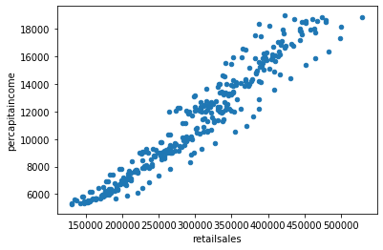
Data Visualization
 | Mean | SD | min | max | median | length | miss.val
inventory | 448453 | 110636 | 242006 | 666768 | 452399 | 337 | 0
inventorygrowth | 4 | 4 | -15 | 12 | 4 | 337 | 0
inventorygrowthabovefive | NaN | NaN | NO | YES | NaN | 337 | 0
month | NaN | NaN | 36526 | 36495 | NaN | 337 | 0
percapitagrowth | 5 | 2 | -6 | 9 | 5 | 337 | 0
percapitagrowthabove | NaN | NaN | NO | YES | NaN | 337 | 0
percapitaincome | 11156 | 3864 | 5264 | 18988 | 11137 | 337 | 0
population | 296133 | 21801 | 255331 | 329423 | 297526 | 337 | 0
retailsales | 297972 | 89513 | 130683 | 529345 | 299920 | 337 | 0
unemployment | 6 | 2 | 4 | 10 | 5 | 337 | 0
yoygtenp | NaN | NaN | NO | YES | NaN | 337 | 0
The above scatter plot between retail sales and percapita income clearly reiterates the strong correlation that exists between the two variables.
The values initially are very close to a trend line at lower values, but at higher values, they disperse slightly away from the trend line, indicating non-linear relationship at higher values.
The above table shows statistical summary of variables used. Classification variables have only two attributes min and max.
The numeric variables have all the attributes that include mean, sd/ standard deviation, min, max, median, length.

Slide 7
Principal Component Analysis
Running PCA for two variables
Running PCA for two variables
(Weights) | PC1 | PC2
percapitaincome | -0.172099 | 0.98508
population | -0.98508 | -0.172099
The principal component analysis is used for numerical data series that has large number of variables mainly to to reduce the number of variables.
The main benefit of PCA is to generate few variables that are weighted linear combination of original variables and retail most of the informational from original data set.
The table (Weights) at the left side has value of two principal components Z1 (-0.17209, -0.98508) and Z2 (0.98508, -0.17209) for two variables percapita income and population.
The second table (Variance proportion) shows that the first principal component Z1 explains 99.9% of the total variance while PC2 accounts for 0.09% of the variance. So we can simply drop PC2 and maintain 99.9% of the variability.
(Variance proportion) | PC1 | PC2
Standard deviation | 22130.555 | 661.7341
Proportion of variance | 99.91% | 0.09%
Cumulative proportion | 99.91% | 100.00%
Running PCA for four variables
Running PCA for four variables
(weights) | PC1 | PC2 | PC3 | PC4
percapitaincome | 0.03 | 0.10 | 0.99 | 0.00
population | 0.19 | 0.98 | -0.10 | 0.00
unemployment | 0.00 | 0.00 | 0.00 | -1.00
inventory | 0.98 | -0.19 | -0.01 | 0.00
The third table (Weights) at the left side has value of four principal components Z1 (0.03, 0.19, 0, 0.98) , Z2 (0.10, 0.98, 0, -0.19), Z3 (0.99, -0.1, 0, -0.01) and Z4 (0, 0, -1, 0) for four variables percapita income, population, unemployment and inventory. We can observe that for each variable, not more than two components are needed to explain the variability.
The fourth table (Variance proportion) shows that the first principal component Z1 explains 99.7% of the total variance while PC2 accounts for 0.26% of the variance and Z3 and Z4 have no contribution. So we can simply drop PC2, PC3, PC4 and still maintain 99.74% of the variability.
(Variance proportion) | PC1 | PC2 | PC3 | PC4
Standard deviation | 112680.668 | 5778.837 | 513.561 | 0.610
Proportion of variance | 99.74% | 0.26% | 0.00% | 0.00%
Cumulative proportion | 99.74% | 100.00% | 100.00% | 100.00%

Slide 8
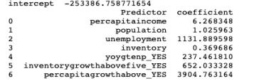
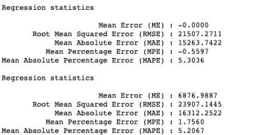
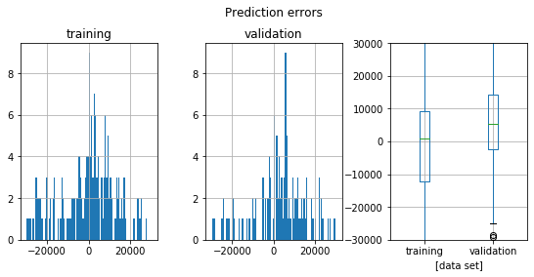
Multiple Linear Regression
Summary of Regressing Variables against retailsales
Regressing predictor Variables against retailsales
The multilinear regression of retailsales against all the variables shows the result as in the Table 1. Knowing the coefficient alone does not give much information.
The Table 2 which shows regression statistics gives better picture as to how well the regression model performed. In the training set, the root mean squared error was 21,507. If we take average of retailsales which is equal to 297,971 and compare with RMSE, then the RMSE of training set is 7.2% of the average retail sales.
In the validation set, the root mean squared error was 23,907. If we again take average of retailsales which is equal to 297,971, then the RMSE of validation set is 8.0% of the average retail sales. Training set performed better than validation set as expected. We will later compare these results with other models to see which model performed well and fits the data better.
In the below plot of errors, we can see that there is larger frequency of error occurrence in the validation set that is captured in the higher RMSE. RMSE need not increase with the variance of the errors. But RMSE increases with the variance of the frequency distribution of error magnitudes as shown in our results and below chart.
Table1: Regression coefficients
Table 2: Regression Statistics

Slide 9

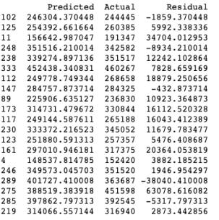
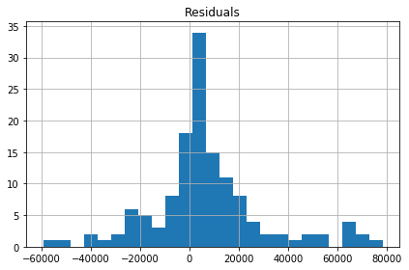
Multiple Linear Regression
Adjusted R², BIC and AIC
R² of 93.8% indicate that 93.8% of variability of retailsales is explained by the variables used as the predictors.
The score of BIC is slightly higher than score of AIC since BIC imposes stronger penalty for including additional variables to the model.
The table shows predicted, actual and residual values from the multi linear regression. RMSE from the residuals as shown in the previous slide was 23,907.1445
The below plot of histogram of residuals shows that residuals are close to being normally distributed with mean of 8872 close to zero and median of 5992 and with the min of -38040 and max of 63,078.

Slide 10
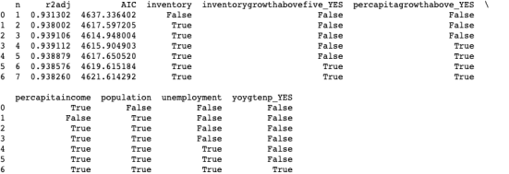
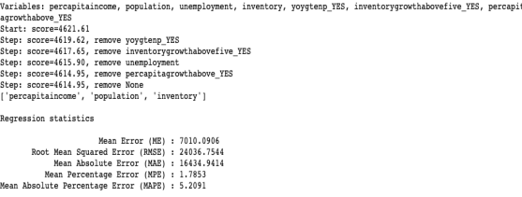
Multiple Linear Regression
Reducing the Number of Predictors using different algorithms
1) Result on Exhaustive search for reducing predictors
1) Exhaustive search for reducing predictors
The output of the exhaustive search shows that the optimal model is model with 4 variables since it has highest R². The variables selected are inventory, percapitaincome, population and percapitagrowthavove_YES.
If AIC is considered, optimal model is model with 3 variables since it has lowest AIC. The variables selected are inventory, percapitaincome and population.
2) Backward elimination
2) Result on Backward elimination
The backward elimination process eliminates least significant variable at each step and stops at step when all the remaining variables make significant contribution. As seen in the output table at the right, percapita income, population and inventory prove to adequate variables.
The regression statistics from the model show that RMSE of 24,036 is slightly higher than RMSE from normal regression of 23,907

Slide 11
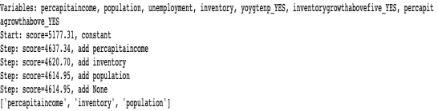
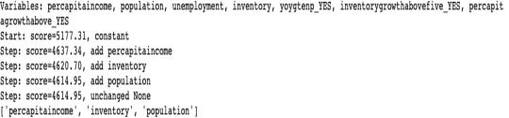
Multiple Linear Regression
Reducing the Number of Predictors using different algorithms
3) Forward selection for reducing predictors
3) Result on forward selection for reducing predictors
The output of the forward selection shows that the optimal model is model with 3 variables namely percapita income, population and inventory. Forward selection starts with best variable and then adds variable in the next step which has largest additional contribution to R². It stops when no further value addition exits.
Note that the variables picked in this model is same as backward selection.
4) Stepwise selection
4) Result on Backward elimination
The Stepwise regression is similar forward selection except that at each step, the model drops predictors that are not statistically significant, as in backward elimination.
The result shows that the optimal model is model with 3 variables namely percapita income, population and inventory

Slide 12
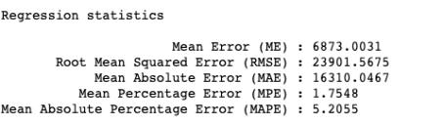
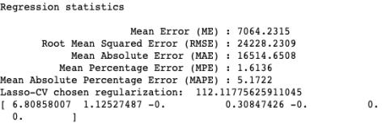
Multiple Linear Regression
Reducing the Number of Predictors using regularization/ Shrinkage Models
5) Lasso
5) Result on Lasso
In linear regression coefficients are estimated by minimizing the training data sum of squared errors (SSE); however, in ridge regression and lasso the coefficients are estimated by minimizing the training data SSE, subject to the penalty term being below some threshold t. This threshold can be set by the user or chosen by cross-validation.
Output on Lasso: The RMSE from Lasso using alpha/ threshold = 1 is 23901 which very slightly lower than normal regression model, which proves Lasso model does good if not better job in making predictions.
6) Result on LassoCV
6) LassoCV
Output on LassoCV: The RMSE from LassoCV is 24228 which is slightly higher than normal regression model.
The methods LassoCV, RidgeCV, and BayesianRidge offer the added benefit of automatically selecting the penalty parameter. However, the LassoCV does not add much value compared to Lasso.

Slide 13
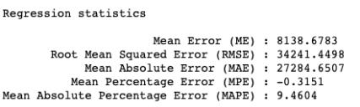
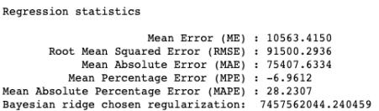
Multiple Linear Regression
Reducing the Number of Predictors using regularization/ Shrinkage Models
7) Ridge
7) Result on Ridge
Same as in lasso, in ridge regression, the coefficients are estimated by minimizing the training data SSE, subject to the penalty term being below some threshold t. This threshold can be set by the user or chosen by cross-validation.
Output on Ridge: The RMSE from ridge, using alpha/ threshold = 1, is 34241 which higher than normal regression model, which proves Ridge does not add much value compared to Lasso or normal regression model.
8) Result on Bayesian Ridge
6) Bayesian Ridge
Output on Bayesian Ridge: The RMSE from Bayesian Ridge is 91,500 which is way higher than normal regression model.
The BayesianRidge offers no benefit compared to Lasso or normal regression model..

Slide 14
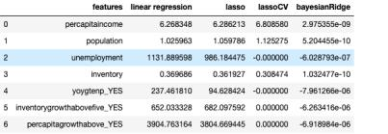
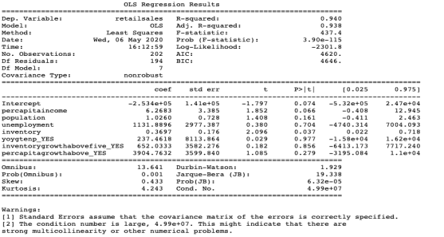
Multiple Linear Regression
Summarizing the results from different Shrinkage Models
Summary of different shrinkage models and linear regression
The table at the right shows what was proved earlier that Lasso closely matches with linear regression; this can be seen through coefficients of predictor variables of Lasso closely matching the linear regression. LassoCV and Bayesian ridge have coefficients of predictor variables different from that of linear regression which makes them not right fit for this data series.
OLS Regression results
The OLS regression output shows R² of 94% which means all the predictor variables together explain 94% of the variation in the retailsales.
The output also shows that the distribution of retailsales has skewness of 0.433 and kurtosis of 4.243

Slide 15
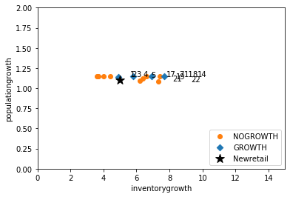
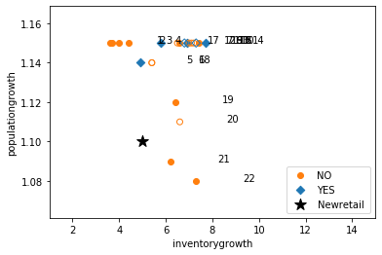
KNN Model
Note: The KNN model uses file retailsales1.csv
Objective: The aim is to train the model to classify the outcome using the new dataset. The outcome variable is the classification variable “yoygtenp” with binary values YES or NO --> if year over year Retail sales growth is above 10% in a month?, using the predictor variables “inventorygrowth” and “populationgrowth”
Plot 1 that shows at what values of populationgrowth and inventorygrowth do we have Retail sales growth is above 10% in a month.
Plot 2 shows the same scatterplot using the training and validation data. The validation points are the ones unfilled.
It can be seen form the plot 2 that the newretail, a new dataset is much closer to the points that indicate “NO”/”NO GROWTH”
Scatterplot of ”yoygtenp” against poulationgrowth and inventorygrowth

Slide 16

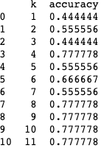
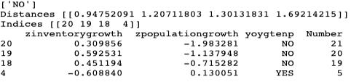
KNN Model
Note: The KNN model uses file retailsales1.csv
We used “newretail” as our new data set that was to be classified by the model. The newretail dataset was assigned the value 'inventorygrowth’ = 5, 'populationgrowth’ = 1.1 .
Once we created train and validation set and ran the K-NN model, with K = 3, we got an output as shown in the table at right side. The model picks the three nearest K members two of which are classified as No and one as YES. Based on the majority rule we can classify the Newretail dataset as NO; which means if 'inventorygrowth’ = 5%, 'populationgrowth’ = 1.1%, then based on the K-NN model, we will see NO GROWTH in the retail sales that will be above 10% in the given month.
Output from K-NN model with K=3
Accuracy (of predictions in the validation set)
The accuracy table shows that the optimal number of K neigbours we need to have in our model is four since it has highest accuracy.
When we retrain the model and run the K-NN, we get the results in the last table which again proves that we can classify the Newretail dataset as NO.
Output from K-NN model with K=4

Slide 17
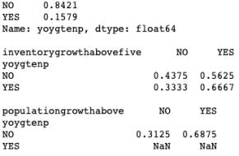
NAÏVE BAYES Model
Note: The naïve bayes model uses file retailsales2.csv
The Naïve bayes model is another model use for classification.
The naïve bayes model works on 3 principles a) For class C1, estimate the individual conditional probabilities for each predictor P(xj|C1). b) Multiply these probabilities by each other, then by the proportion of records belonging to class C1. c)Repeat Steps 1 and 2 for all the classes d) Estimate a probability for class Ci by taking the value calculated in Step 2 for class Ci and dividing it by the sum of such values for all classes. E) Assign the record to the class with the highest probability for this set of predictor values.
Model: We look at Outcome variable“yoygtenp” which will have values YES or NO -- if year over year Retail sales growth is above 10% in a month?
We will use two predictor classification variables --inventorygrowthabovefive and popuulationgrowthabove.
The pivot table at right side shows that there is 84% probability of classifying the outcome as NO/NOGROWTH. The result for inventorygrowthabovefive shows that there is higher probability that when inventorygrowthabovefive is YES, then outcome for yoygtenp is also YES.
Pivot tables for the outcome vs. each of the five predictors
using the training set, in order to obtain conditional probabilities

Slide 18
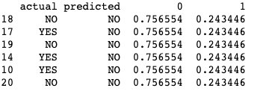
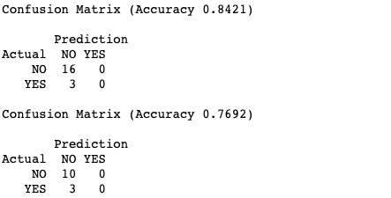
NAÏVE BAYES Model
Note: The naïve bayes model uses file retailsales2.csv
The Prediction for validation set gives output as NO for our outcome variable “yoygtenp” with conditional probability of 75%, when we set inventorygrowthabovefive_YES == 1 & populationgrowthabove_YES == 1
Accuracy (of predictions in the validation set) as defined by Conditional Probability
Confusion matrix reiterates the same result which we found from conditional probability using Naïve Bayes algorithm. For training dataset, the model correctly predicts NO sixteen times and incorrectly predicts NO three times with 84% accuaracy
For Validation dataset, the model correctly predicts NO ten times and incorrectly predicts NO three times with 77% accuracy.

Slide 19
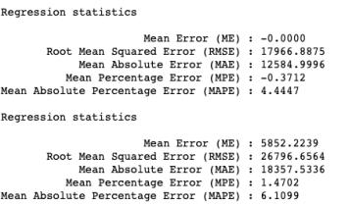
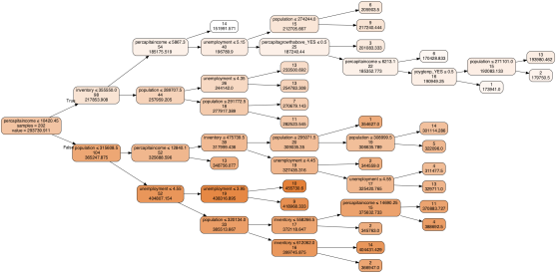
Regression Tree
Note: The regression tree model uses file retailsales.csv
The regression tree method can be used for a numerical outcome variable. Steps: 1) The outcome variable (Y) is a numerical variable. 2) Many splits of predictors are attempted, and for each split , “impurity” is measured in each branch of the resulting tree. The tree procedure then selects the split that minimizes the sum of such measures.
Impurity is simply measure of whether records belong to one particular class or other classes. Lower the impurity the better.
The regression statistcis using the regression tree model provides RMSE of 26,796 which is higher than 23, 907 for linear regression. So, the regression tree is not better off compared to normal linear regression.
The plot shows regression tree with percapitaincome variable at the top. Then as the tree breaks down further, more variables are included.

Slide 20
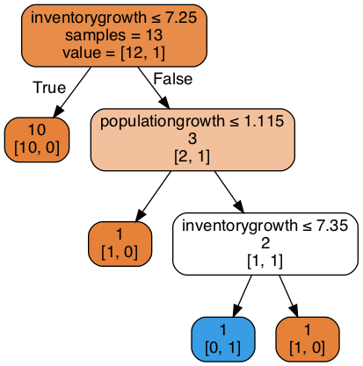
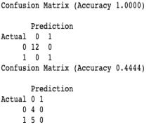
Classification Tree
Note: The classification tree model uses file retailsales1.csv
Similar to regression tree the classification tree involves these steps: 1) The outcome variable (Y) is a classification variable. 2) Many splits of predictors are attempted, and for each split , “impurity” is measured in each branch of the resulting tree. The tree procedure then selects the split that minimizes the sum of such measures.
Impurity is simply measure of whether records belong to one particular class or other classes. Lower the impurity the better.
The classification tree starts with inventory growth and it has twelve classifications as NO and one as YES for variable “yoygtenp”. The node then splits to two child nodes. If the inventory growth is less than 7.25%, then tree yields ten classifications as NO at left child. If the inventory growth greater than 7.25%, then tree yields two classifications as NO and one classification as YES at right child node. The process continues until terminal node.
The classification model does great job for training dataset with 100% accuracy by predicting the classification as NO for “yoygtenp” which was actually correct.
For validation set, the model correctly classifies four instances as NO and incorrectly classifies five instances as NO.

Slide 21
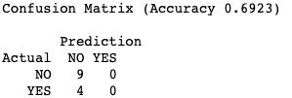
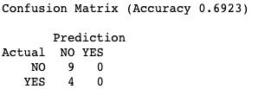
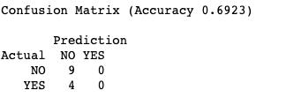
Ensembles
Note: This tree model uses file retailsales2.csv
Ensembles:
In prediction tasks, where the outcome variable is numerical, it is possible to combine the predictions from the different methods by taking an average or median or weighted average. This is the principle behind the Ensembles model.
Outcome variable: yoygten
Predictor variables: inventorygrowthabovefive and populationgrowthabove
Single Tree: This is the normal classification tree previously discussed. The accuracy for this model is 69% with 9 instances correctly classified as NO and 4 cases incorrectly classified as NO.
Bagging: Another form of ensembles based on averaging across multiple random data samples. Bagging, short for “bootstrap aggregating,” comprises two steps: 1. Generate multiple random samples. 2. Running an algorithm on each sample and producing scores. The accuracy for this model is 69% with 9 instances correctly classified as NO and 4 cases incorrectly classified as NO, same as single tree.
Boosting: Focus is to directly improve areas in the data where our model makes errors, by forcing the model to pay more attention to those records. The confusion matrix shows the models gives same results as bagging.

Slide 22
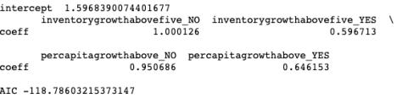

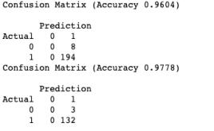
Logistic Regression
Note: This tree model uses file retailsales.csv
Logistics Regression:
The model is used to predict the classification outcome variable. The idea behind logistic regression is straightforward: Instead of using Y directly as the outcome variable, we use a function of it, which is called the logit./logistic response function that gives probability as output.
Aim: We want to see if inventory growth above 5% and percapita growth above 1.1% can result in retail sales above 10%.
When cases 27, 93, 21 and 70 were picked to check the accuracy of the model, the model accurately predicted the outcome as YES, as show in the table at the right.
The confusion matrix, shows the accuracy for entire training and validation set; The training set has accuracy of 96% while validation set has accuracy of 97.8%. This shows the logistic regression performed better in classifying the outcome variable.
Output of Logistic Regression

Slide 23
Conclusion
In the regression, we tested different methods and regression models to optimize the number of variables and improve the output.
Based on the output, we can conclude that Multiple regression model and LASSO performed well in fitting the data series and predicting the outcome. This can be seen in lowest RMSE and MAE for these two models. Backward elimination and other predictor reduction methods are useful when we have large number of predictor variables to chose from.
In the classification, we tested the data series for different models to check which model performed better in predicting if retail sales growth was above 10%.
With 97% accuracy the logistic regression model performed well. Next best model were Naïve Bayesand KNN model with 77% accuracy. Ensembles did decent job with 69% accuracy while classification tree was poor performer.
 |  | Regression
 | RMSE | MAE | Outcome variable | Predictors
Multi Linear Regression | 23907 | 16312 | Retailsales | All Variables
Backward Elimination | 24036 | 16434 | Retailsales | Percapitaincome, Population and Inventory
Lasso | 23901 | 16310 | Retailsales | All Variables
LassoCV | 24228 | 16514 | Retailsales | All Variables
Ridge | 34241 | 27284 | Retailsales | All Variables
Bayesian Ridge | 91500 | 75407 | Retailsales | All Variables
Regression tree | 26796 | 18357 | Retailsales | All Variables
 |  | Classification
 | Accuracy | Outcome variable | Predictors
KNN Model | 77% | yoygtenp | Inventory Growth and Population Growth
Naïve Bayes | 77% | yoygtenp | inventorygrowthabovefive and popuulationgrowthabove
Classification Tree | 44% | yoygtenp | inventorygrowthabovefive and popuulationgrowthabove
Ensembles/Single tree | 69% | yoygtenp | inventorygrowthabovefive and popuulationgrowthabove
Ensembles/Bagging | 69% | yoygtenp | inventorygrowthabovefive and popuulationgrowthabove
Ensembles/Boosting | 69% | yoygtenp | inventorygrowthabovefive and popuulationgrowthabove
Logistic Regression | 97% | yoygtenp | inventorygrowthabovefive and percapitagrowthabove

Slide 24


END
Q&A

